Slide 1
HR Dashboard Guide
By soon to be Data Analyst Dovydas Kiškelis

Slide 2
Current Number of Employees - Shows how many employees the company has as of today (in this old dataset “today” is 2004-01-01). This KPI ignores any date-range filters but still respects gender, department, or other attribute filters.
Average Tenure in Company (years) - Shows the average length of service for employees currently active as of the selected date. Honors all filters. If you apply a date-range filter, it treats anyone hired before the end of that range as still active and computes their tenure up to that end date.
Turnover Rate (%) - Shows how many people left the company, relative to how many are active today. Accepts all filters. Calculated as : Churned Employees / Current Number of Employees.
Turnover Rate (%)- Average Tenure in Company (years) - shows year-to-date hires minus year-to-date leavers, giving the net headcount growth (or decline) so far this year. Accepts all filters so it’s possible to see what was the change in any date period.

Slide 3
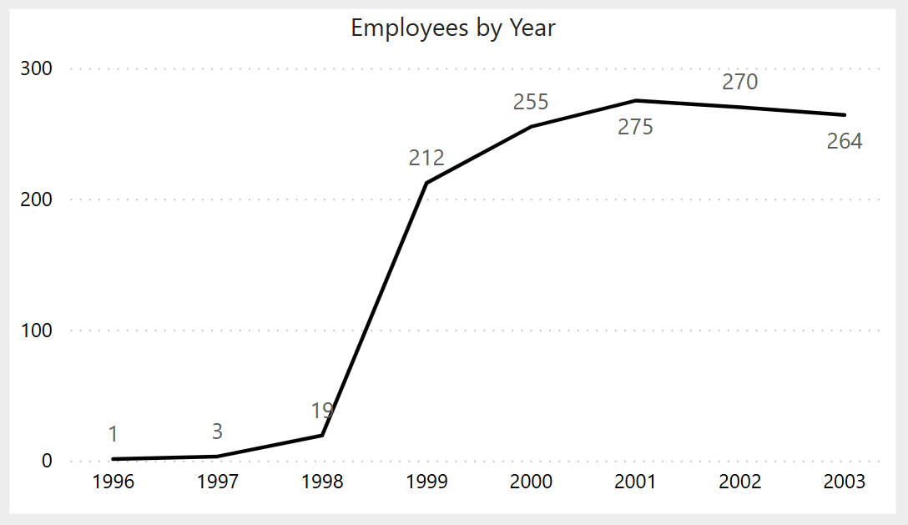
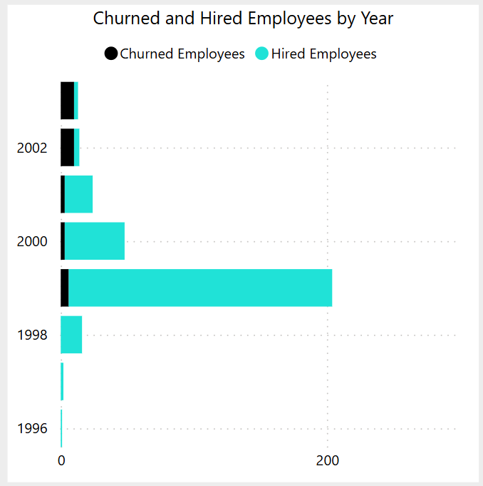
Employees by Year - Shows how active headcount rises and falls over the selected date range - updated dynamically by the date slicer and still respecting any department, gender or other attribute filters - displayed as a line chart with data-point markers and hover tooltips for quick trend analysis and anomaly spotting.
Churned and Hired Employees by Year - Shows yearly counts of employees who left versus those hired over the selected date range - updated by the date slicer and still honoring any department, gender or other attribute filters

Slide 4
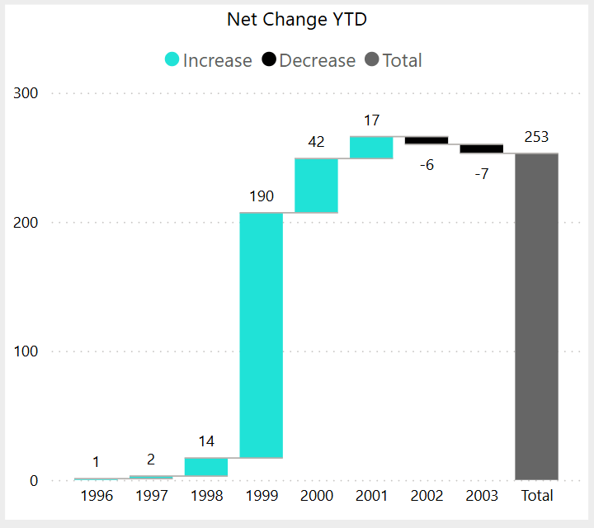
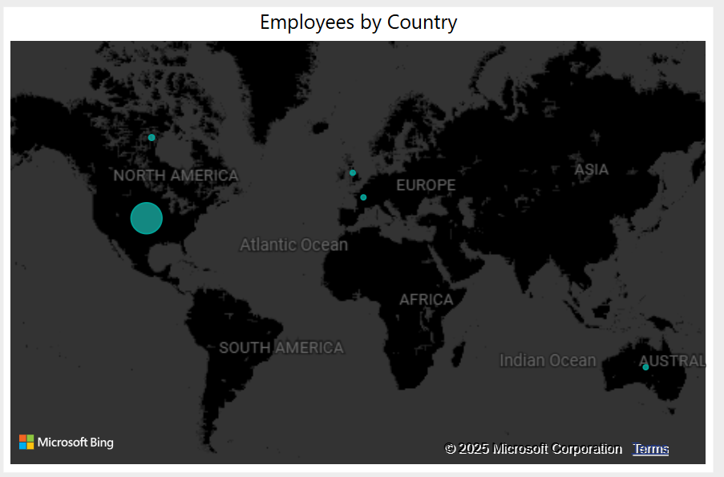
Net Change YTD - Shows the year-by-year net headcount change over the selected date range - updated dynamically by the date slicer and still honoring any department, gender or other attribute filters.
Employees by Country - Shows current active headcount by country - with the number of employees in each location. It ignores any date slicer (always reflecting the latest snapshot) but still filters by department, gender, or other attributes.

Slide 5
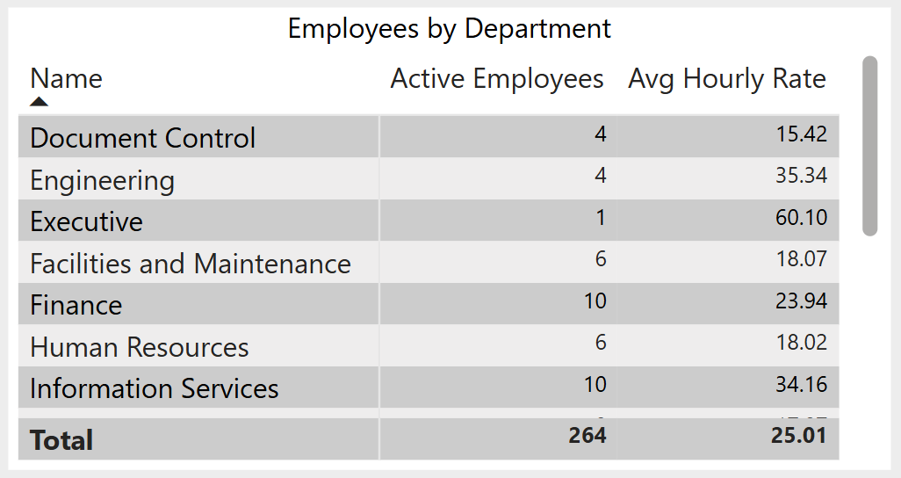
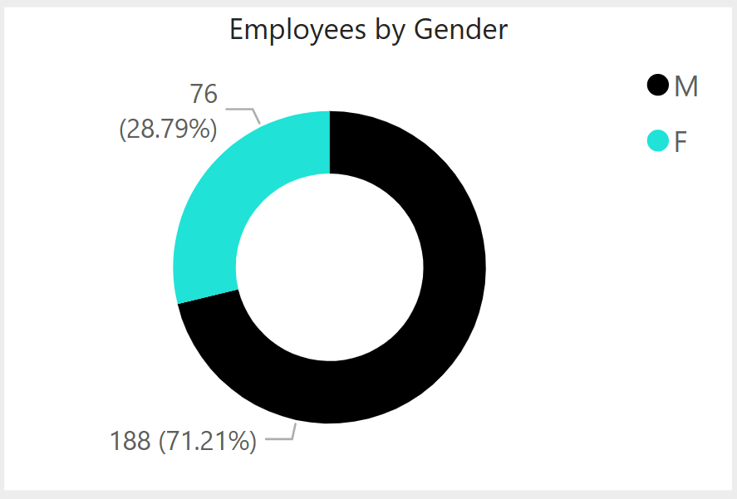
Employees by Department - Shows a breakdown by department of how many people are active as of the selected date alongside each department’s average hourly rate - updated dynamically by date slicer and still honoring any department, gender or other filters.
Employees by Gender - Shows the split of your active workforce by gender as of the selected date - updated dynamically by date slicer and still honoring any department, location or other filters.

Slide 6
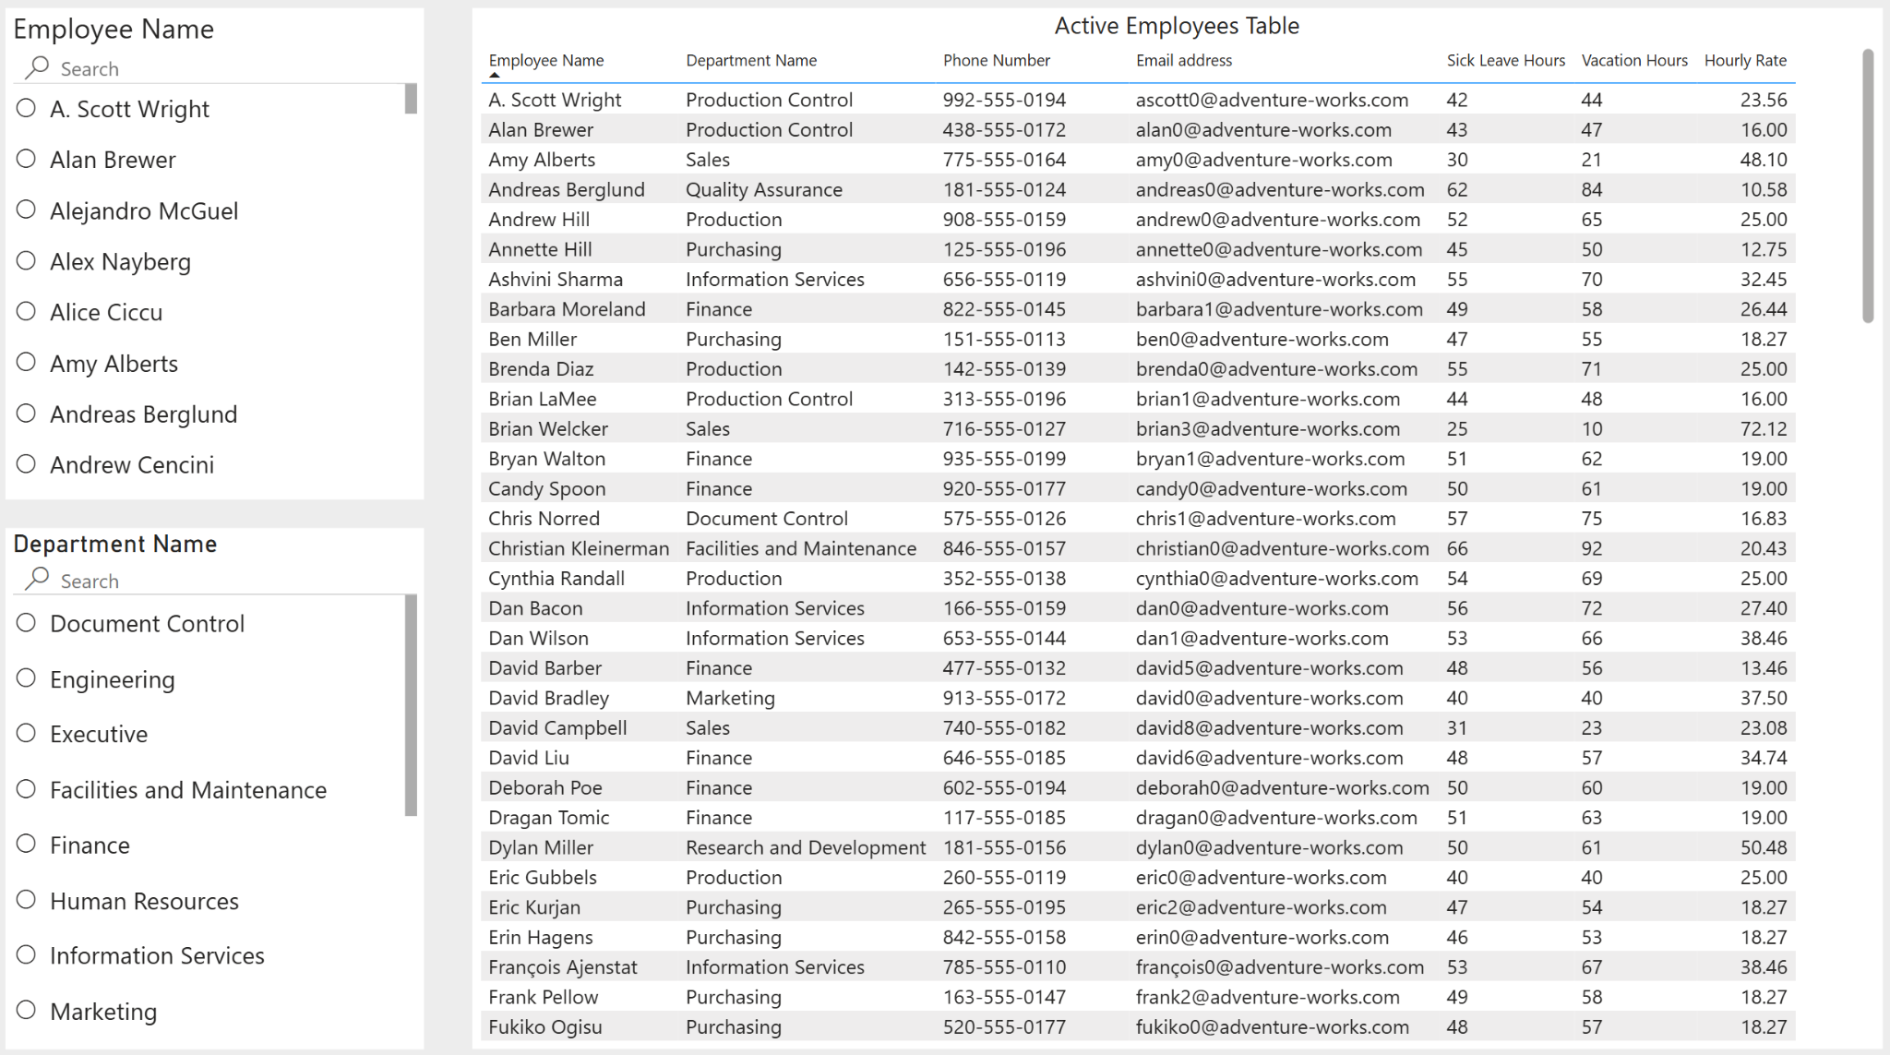
Employees Details (second sheet) - Shows a detailed, filterable list of active employees - complete with department, contact info, leave balances and hourly rate - driven by the Employee Name and Department Name slicers so you can instantly find and inspect anyone’s current record. Hover over an employee’s name to see their photo.

